Slide 1
Topic 16
Queues
"FISH queue: n.
  [acronym, by analogy with FIFO (First In, First Out)] ‘First In, Still Here’. A joking way of pointing out that processing of a particular sequence of events or requests has stopped dead. Also FISH mode and FISHnet; the latter may be applied to any network that is running really slowly or exhibiting extreme flakiness."
  -The Jargon File 4.4.7

Slide 2
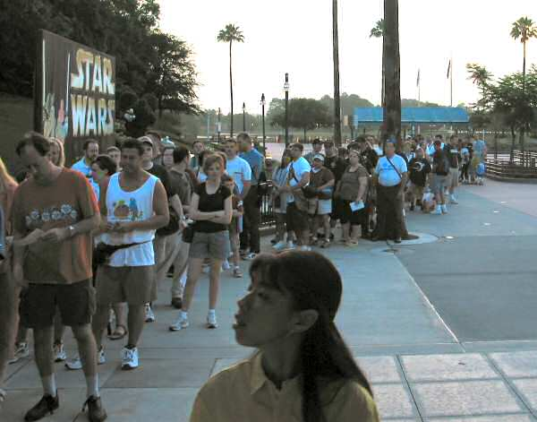

Queues
A sharp tool, like stacks
A line
  In England people don’t “get in line”
  they “queue up”.
CS314
Queues

Slide 3
Queue Properties
Queues are a first in first out data structure
  FIFO (or LILO, but that sounds a bit silly)
Add items to the end of the queue
Access and remove from the front
  Access to the element that has been in the structure the longest amount of time
Used extensively in operating systems
  Queues of processes, I/O requests, and much more
CS314
Queues

Slide 4
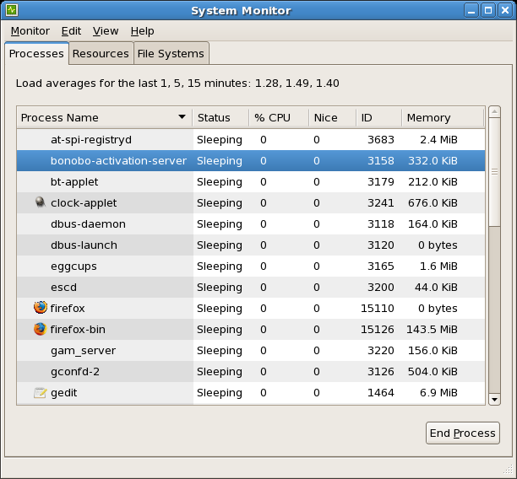
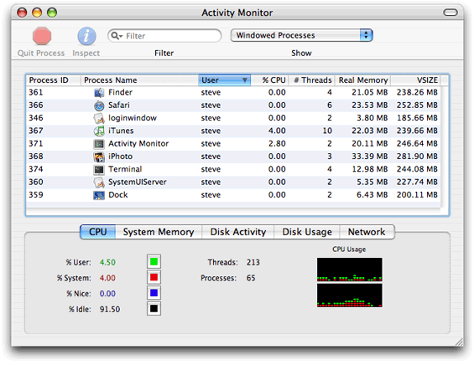
Queues in Operating Systems
On a computer with N cores on the CPU, but more than N processes, how many processes can actually be executing at one time?
One job of OS, schedule the processes for the CPU
CS314
Queues

Slide 5
Queue operations
void enqueue(E item)
  a.k.a. add(E item)
E front()
  a.k.a. E peek()
E dequeue()
  a.k.a. E remove()
boolean isEmpty()
Specify methods in an interface, allow multiple implementations.
CS314
Queues

Slide 6
Queue interface, version 1
public interface Queue314<E> {
//place item at back of this queue
public void enqueue(E item);
//access item at front of this queue
//pre: !isEmpty()
public E front();
//remove item at front of this queue
//pre: !isEmpty()
public E dequeue();
public boolean isEmpty();
}
CS314
Queues

Slide 7
Implementing a Queue
Given the internal storage container and choice for front and back of queue what are the Big O of the queue operations?
ArrayList LinkedList LinkedList
(Singly Linked) (Doubly Linked)
enqueue
front
dequeue
isEmpty
CS314
Queues

Slide 8
Clicker 1
If implementing a queue with a singly linked list with references to the first and last nodes (head and tail) which end of the list should be the front of the queue in order to have all queue operations O(1)?
The front of the list should be the front of the queue.
The back of the list should be the front of the queue.
Either end will work to make all ops O(1).
Neither end will allow all ops to be O(1).
CS314
Queues

Slide 9

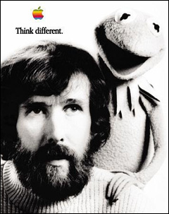
Alternate Implementation
How about implementing a Queue with a native array?
  Seems like a step backwards
CS314
Queues

Slide 10
Application of Queues
Radix Sort
  radix is a synonym for base. base 10, base 2
Multi pass sorting algorithm that only looks at individual digits during each pass
Use queues as buckets to store elements
Create an array of 10 queues
Starting with the least significant digit place value in queue that matches digit
empty queues back into array
repeat, moving to next least significant digit
CS314
Queues

Slide 11
Radix Sort in Action: 1s place
original values in array
  9, 113, 70, 86, 12, 93, 37, 40, 252, 7, 79, 12
Look at ones place
  9, 113, 70, 86, 12, 93, 37, 40, 252, 7, 79, 12
Array of Queues (all empty initially):
  0 5
  1 6
  2 7
  3 8
  4 9
CS314
Queues

Slide 12
Radix Sort in Action: 1s
original values in array
  9, 113, 70, 86, 12, 93, 37, 40, 252, 7, 79, 12
Look at ones place
  9, 113, 70, 86, 12, 93, 37, 40, 252, 7, 79, 12
Queues:
  0 70, 40 5
  1 6 86
  2 12, 252, 12 7 37, 7
  3 113, 93 8
  4 9 9, 79
CS314
Queues

Slide 13
Radix Sort in Action: 10s
Empty queues in order from 0 to 9 back into array
  70, 40, 12, 252, 12, 113, 93, 86, 37, 7, 9, 79
Now look at 10's place
  70, 40, 12, 252, 12, 113, 93, 86, 37, 7, 9, 79
Queues:
  0 7, 9 5 252
  1 12, 12, 113 6
  2 7 70, 79
  3 37 8 86
  4 40 9 93
CS314
Queues

Slide 14
Radix Sort in Action: 100s
Empty queues in order from 0 to 9 back into array
  7, 9, 12, 12, 113, 37, 40, 252, 70, 79, 86, 93
Now look at 100's place
  __7, __9, _12, _12, 113, _37, _40, 252, _70, _79, _86, _93
Queues:
  0 7, 9, _12, _12, _37, _40, _70, _79, _86, _93 5
  1 113 6
  2 252 7
  3 8
  4 9
CS314
Queues

Slide 15
Radix Sort in Action: Final Step
Empty queues in order from 0 to 9 back into array
  7, 9, 12, 12, 40, 70, 79, 86, 93, 113, 252
CS314
Queues

Slide 16
Radix Sort Code
public static void sort(int[] list){
ArrayList<Queue<Integer>> queues = new ArrayList<Queue<Integer>>();
for(int i = 0; i < 10; i++)
queues.add( new LinkedList<Integer>() );
int passes = numDigits(list[0]); // helper method
// or int passes = (int) Math.log10(list[0]);
for(int i = 1; i < list.length; i++){
int temp = numDigits(list[i]);
if( temp > passes )
passes = temp;
}
for(int i = 0; i < passes; i++){
for(int j = 0; j < list.length; j++)
queues.get(valueOfDigit(list[j], i)).add(list[j]);
int pos = 0;
for(Queue<Integer> q : queues){
while(!q.isEmpty())
list[pos++] = q.remove();
}
}
}
CS314
Queues

